Slide 1
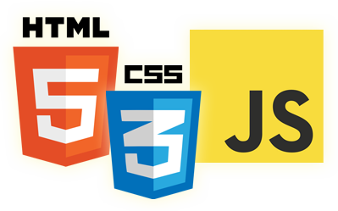

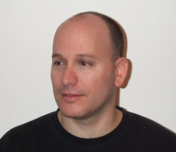
ECMAScript 6.0
Eyal Vardi
Microsoft MVP ASP.NET blog: eyalvardi.wordpress.com

Slide 2
“Everything that can be written in JavaScript will eventually be written in JavaScript”. (Atwood’s law)

Slide 3
JavaScript History

Slide 4
In The Beginning...
In 1995 Netscape hired a young lad by the name of Brenden Eich to take charge of designing a new language.
Sun and ECMA decide to standardize JavaScript and create 'ECMAScript'.

Slide 5
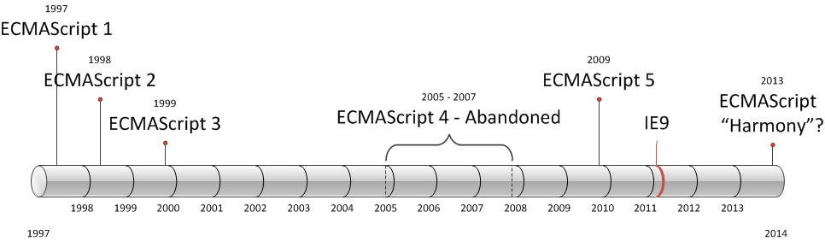
ECMAScript Versions
ECMAScript 6.0 (mid 2015)

Slide 6
Terminology
TC39 (Ecma Technical Committee 39)
The committee evolving JavaScript.
ECMAScript
The official name of the language
JavaScript
The language
Formally: one implementation of ECMAScript

Slide 7
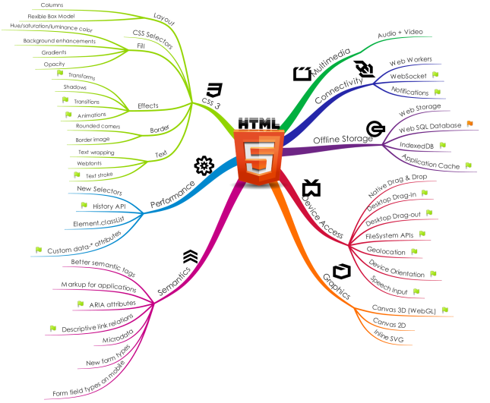
HTML 5 )Changes The Rules of The Game(

Slide 8


Traditional apps
Browser Request
Index.html
MVC4
Traditional Request / Response for ALL rendered content and assets

Slide 9
Web Application (SPA)
Initial Request
Application.htm
RequireJS Loader
Application.js (bootstrap)
MVC4
Page1 Partial.htm
ViewModel (#index)
IndexViewModel.js
ViewModel (#login)
JSON Requests
Model (LoginModel)
Handling disconnection
HTML5 localstorage

Slide 10
SOAP vs. JSON
SOAP WSDL
HTTP

Slide 11
What’s new in ECMAScript 6.0
JavaScript history
Syntax
Functions
Classes
Collections
Iterators & Generators
Template String
Modules
Proxy

Slide 12

ParallelJS
Parallelizes JavaScript code that uses the array methods mapPar(), filterPar() and reducePar().
Array.prototype.mapPar()
Array.prototype.filterPar()
Array.prototype.reducePar()
Thread 2
Thread 1
Thread 3
Thread 1
Thread 4

Slide 13

Web Components

Slide 14
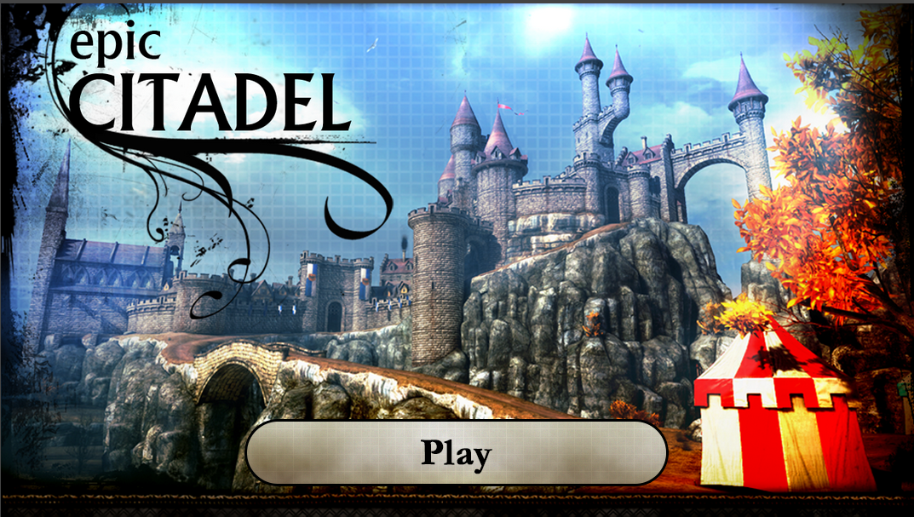
Near-Native Performance (ASM.JS)
* Chrome and Opera Optimize for Mozilla-Pioneered Asm.js

Slide 15
Resources
2ality blog (http://www.2ality.com/)
Understanding ECMAScript 6
http://ecmascript6.org/
A Few New Things Coming To JavaScript
Harmony of Dreams Come True
Harmony specification_drafts

Slide 16
Thanks
eyalvardi.wordpress.com
Eyal Vardi
Microsoft MVP ASP.NET blog: eyalvardi.wordpress.com

